Slide 1
Click Through Rate Analysis
Submitted By :-
SIDDHAY SUBHASH SHETYE

Slide 2
INDEX :-
Problem Statement
Business Task
Exploratory Data Analysis (EDA).
A. Import all Libraries & Display the Dataset
B. No. of rows and columns and list of columns in the dataset
C. Data Types of all columns before EDA
D. Find the Missing values of the Dataset with respect to the Percentage
E. Drop the unnecessary columns, replace empty rows and change the datatypes of columns
F. Add a new Column as CTR (Click Through Rate)
G. Add a new Column Spend Budget Per day
H. Compare changes Before and After EDA
Visualization
A. Visualization of CTR over Full Duration and for the last 7 days
B. Spent budget per day with respect to a number of Days
C. No. of days VS Click & Impressions
D. Impression VS Clicks with Channel Distribution
E. Top 10 Advertise Distributors
F. Correlation in Data
5. Split the data into features (X), target variable(Y), test and train the dataset
6. ML Models
A. Linear regression Model
I. The first few predictions and actual values for the Linear regression Model
II. Cross Validation for Linear Regression
B. K-Nearest Neighbor Model
I. The first few predictions and actual values for the K-Nearest Neighbor Model
C. Decision Tree model
I. The first few predictions and actual values for the Decision Tree Model
D. Random Forest model
I. The first few predictions and actual values for the Random Forest model

Slide 3
Problem Statement
Dell is not happy with the performance of their recent marketing initiatives, They have asked you to analyze the data to understand the problem and provide solutions.
They want to increase conversions for their product. They have been running marketing initiatives on various websites, YouTube, Facebook, Instagram, and other platforms, but these initiatives have not been successful.
They need to predict the click-through rate (CTR) of their ads for the next 10 days so that they can improve their performance and increase conversions.

Slide 4
Business Task
To identify the problem, analyze the data, develop a predictive model, and provide actionable insights.

Slide 5

Exploratory Data Analysis (EDA).

Slide 6
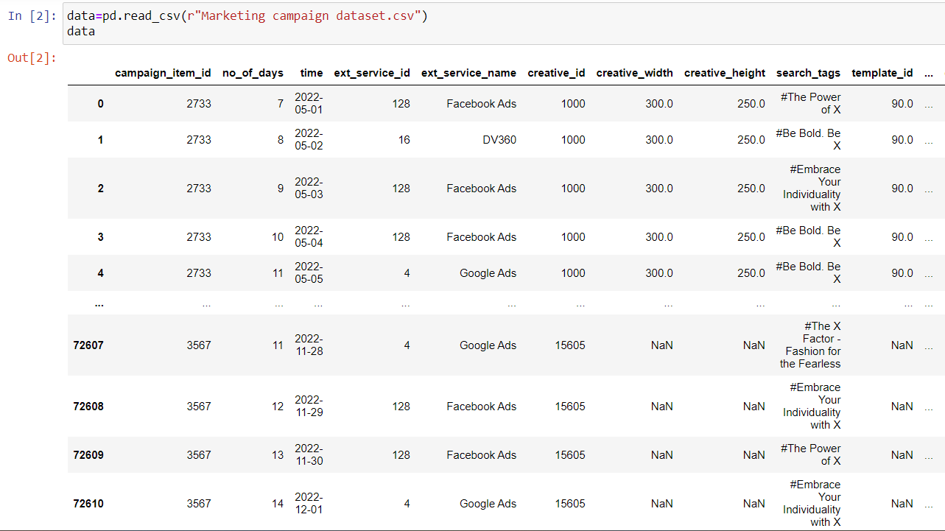
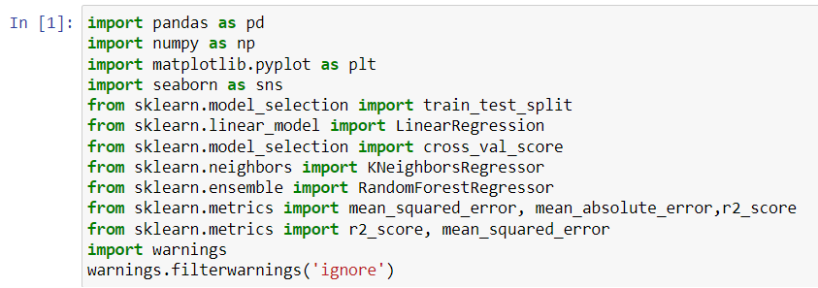
Import all Libraries
Display the Dataset

Slide 7
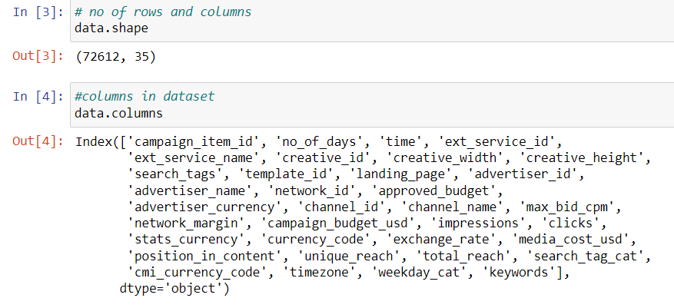
No. of rows and columns and list of columns in the dataset

Slide 8
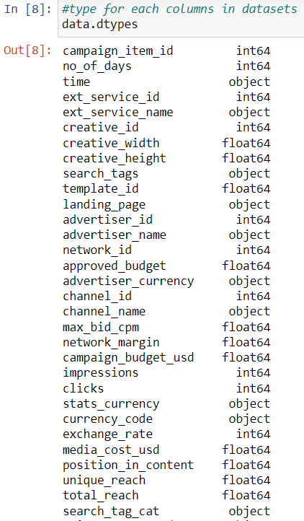
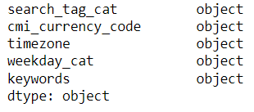
Data Types of all columns before EDA

Slide 9
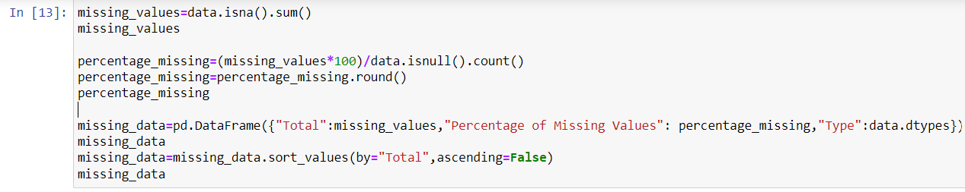
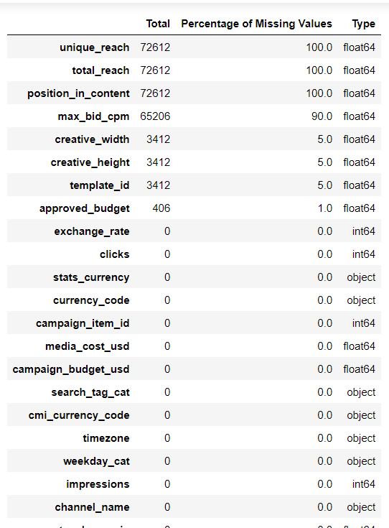
Find the Missing values of Dataset with respect to Percentage
Here we Find the total missing values from the Dataset through “isna().sum()” function
Measure its Percntage of empty rows in perticular columns
Sort them in Decending order
Display Datatypes of respective columns

Slide 10
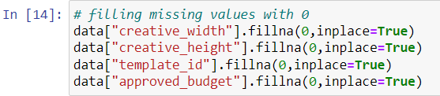
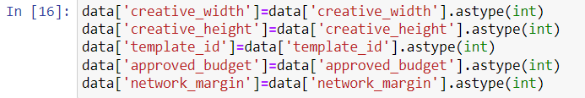
Drop the unnecessary columns ,replace empty rows and change datatypes of columns
Based on missing data table there are 4 columns who has missing values above 50% , so just delete/Drop the columns
Handling missing values by filling it with 0 using fillna function
change Data Types to integer

Slide 11
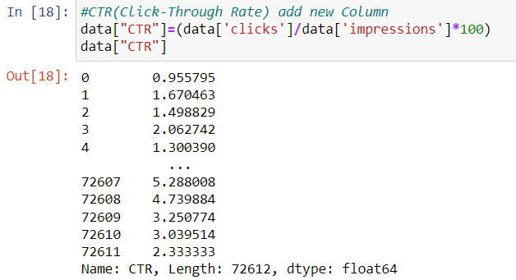
Add new Column as CTR (Click Through Rate)
CTR stands for click-through rate.
It is a metric that measures the percentage of people who see an online advertisement and then click on it.
The formula for calculating CTR is:
CTR = (Clicks / Impressions) x 100

Slide 12
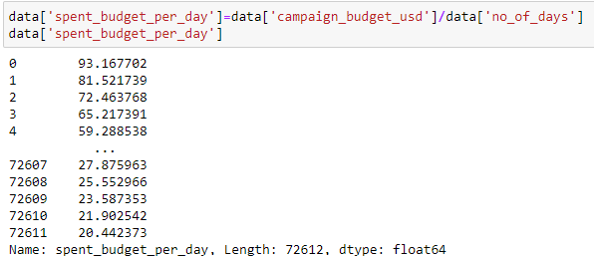
Add new Column Spend Budget Per day
Spent budget per day is a new column which tells what is the budget for a day
The formula for calculating Spent budget per day is:
Spent_budget_per_day =
(Campaign_budget_usd /
number_of_days)

Slide 13
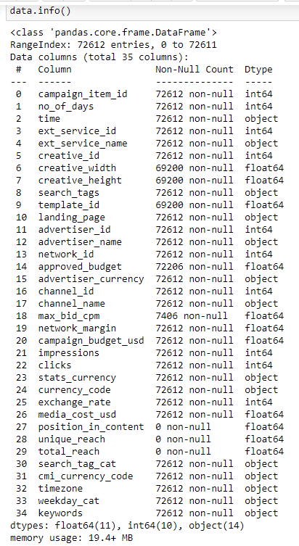
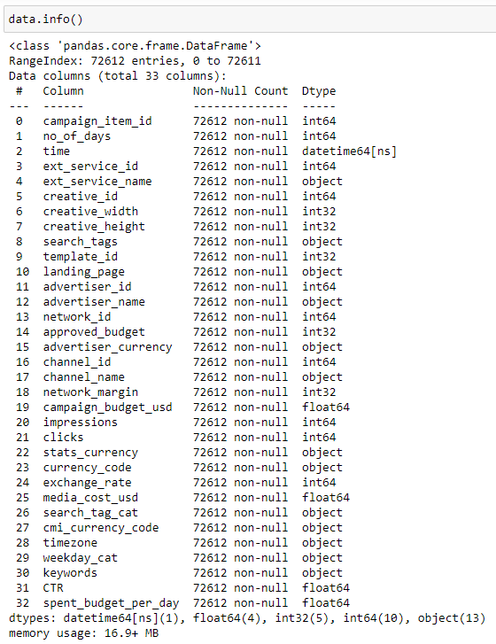
Compare changes Before and After EDA
Before EDA
After EDA

Slide 14

Visualization

Slide 15
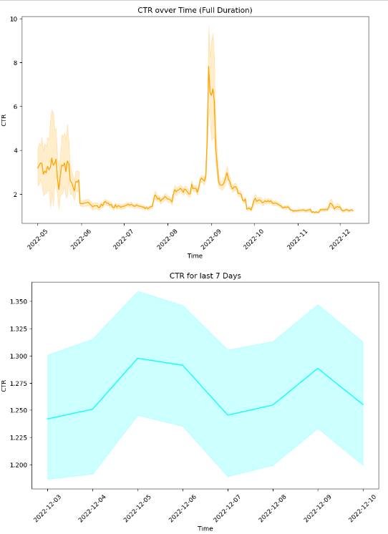
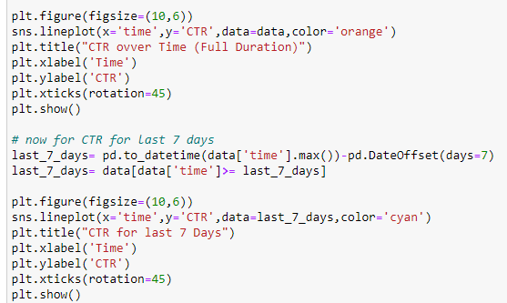
Visualization of CTR over Full Duration and for last 7 days
Insights:-
For this visualization we use line plot ,Based on our visualization we conclude that in september we get a most of views and clicks on our online advertise.

Slide 16
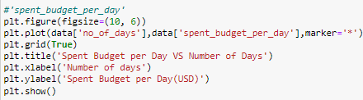
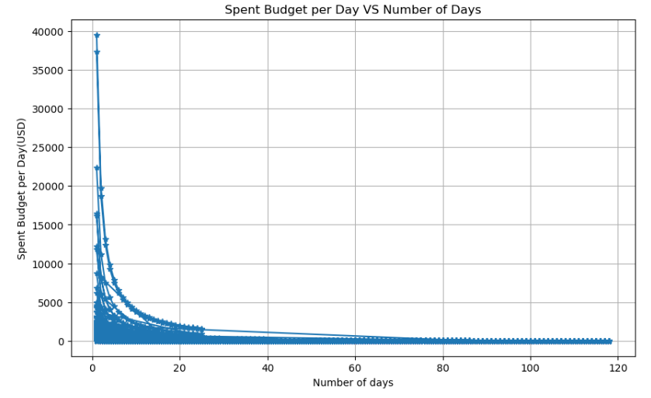
Spent budget per day with respect to number of Days
Insights :-
The number of days increases in a campaign, the number of impressions and clicks tends to decrease, This suggests that optimization based on the performance metric.
Outliers in the graphs represent sudden spikes in impressions and clicks, potentially influenced by events such as festivals or social media popularity. Further analysis can be done to identify specific periods, days, seasons, festivals, or holidays when performance tends to increase.
CTR, is necessary for long campaigns to avoid poor performance despite exhausting the budget. By comparing the spent budget with the number of days.

Slide 17
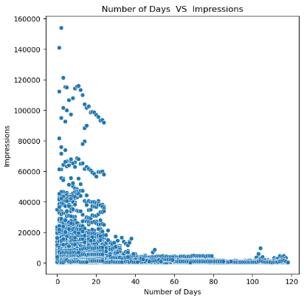
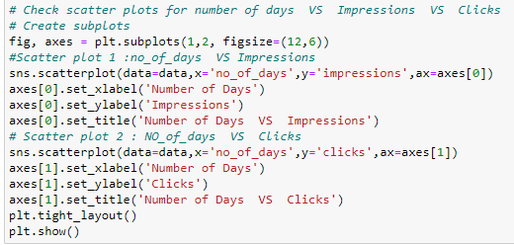
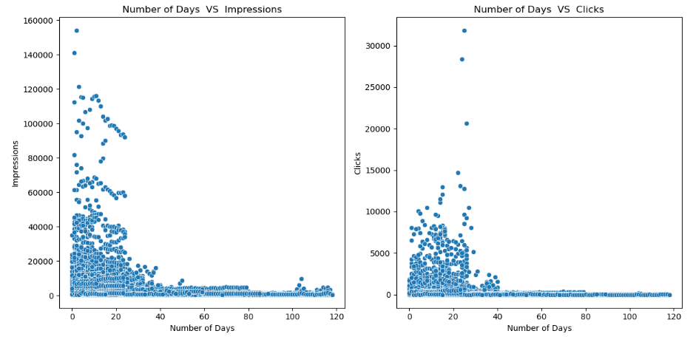
No. of days VS Click & Impressions
Insights :-
number of Clicks and Impression have decreased over the period of time

Slide 18
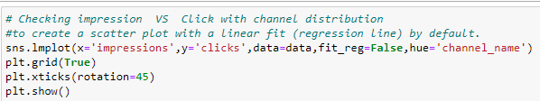
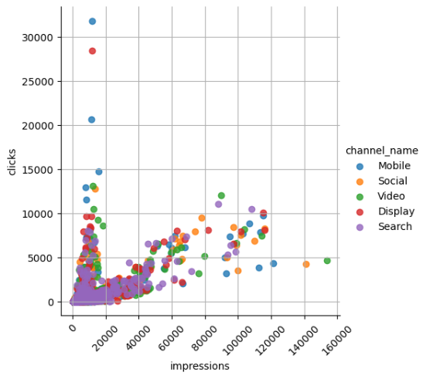
Impression VS Clicks with Channel Distribution
Insights :-
Mobile campaigns receive more clicks compared to other campaigns. If a campaign is performing poorly for a prolonged period and needs to be paused, reallocating its budget to mobile campaigns can be beneficial.
Search campaigns have lower impressions and clicks, indicating a need for improvement. Enhancing the performance of search campaigns can be achieved by using effective keywords, search tags, and compelling call-to-action strategies.
Social campaigns & video have a wider reach but struggle to generate conversions. To improve the effectiveness of social campaigns, emphasis should be placed on enhancing the creative elements and making them more engaging to the target audience.

Slide 19
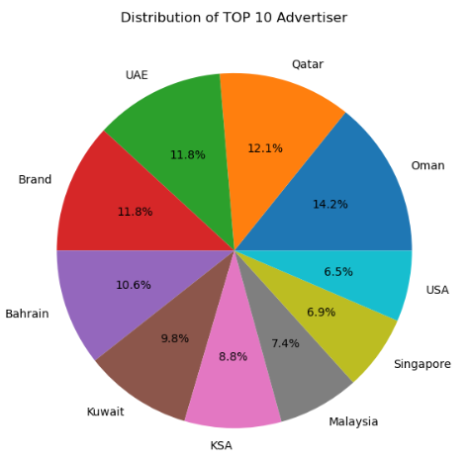
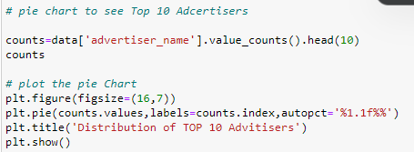
Top 10 Advertise Distributor
Insights :-
Based on our Data Most of Our Distributor is from Saudi Arabic Region

Slide 20
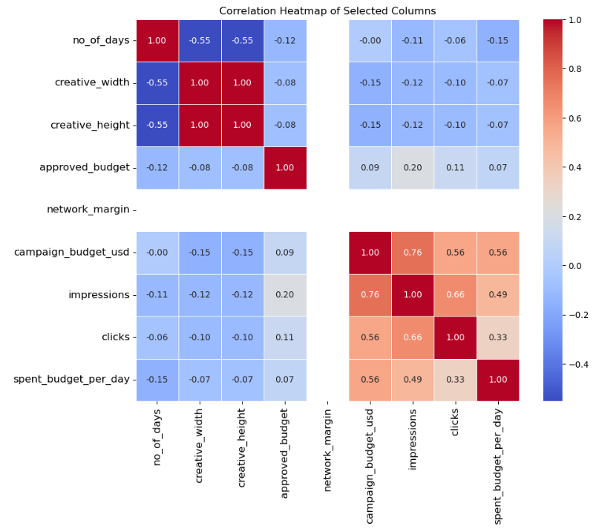
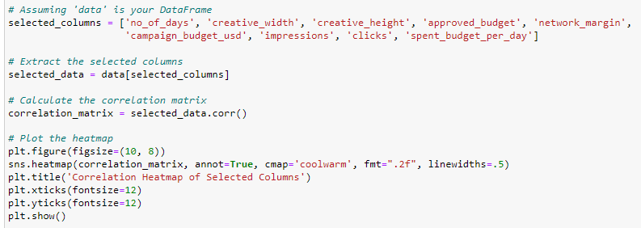
Correlation in Data
Insights :-
Based on our dataset we get relationships between different variables in a dataset by correlation matrix

Slide 21
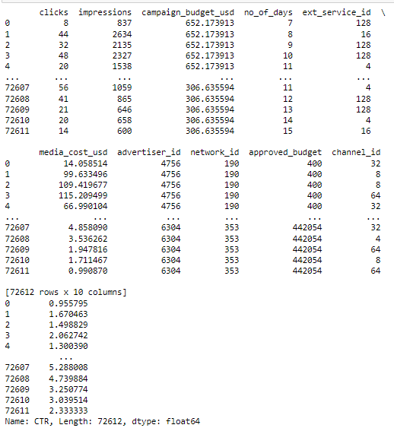

Split the data into features (X) , target variable(Y), test and train dataset
We Split the data into 2 parts as Features (X) & Target (Y)
Then this 2 variables are again divided into 2 parts namely Train which contain 80% data and Test which contain 20% data

Slide 22

Machine Learning Models

Slide 23
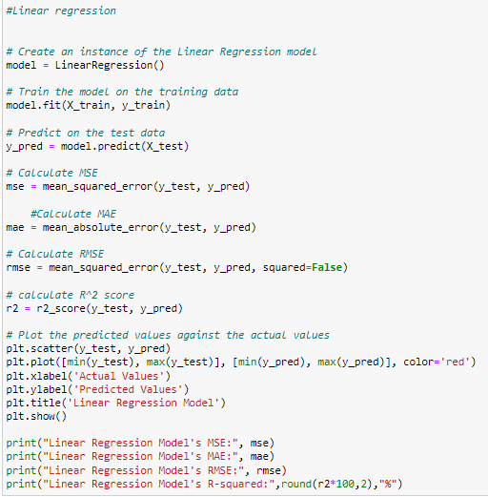
Linear regression Model

Slide 24
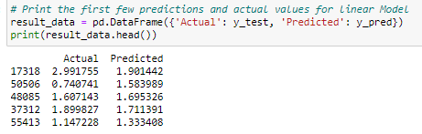
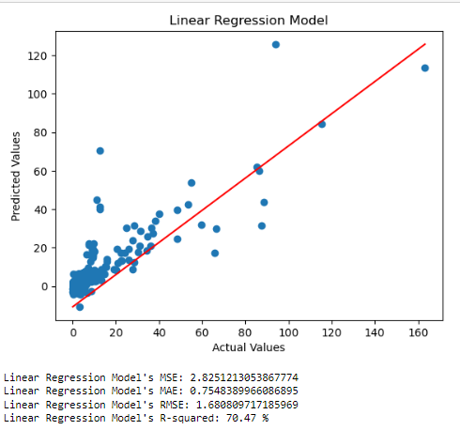
The first few predictions and actual values for Linear regression Model
We Train our splitted dataset in Linear Regression model
calculate its performance in Mean Squared Error,Mean Absolute Error and Root of Mean Square error and Finally R-Squared %
Display the 5 values of Actual Values (y_test) and Predicted Values ( y_pred)
Plot A Scatter plot based on Actual Values and Predicted Values

Slide 25
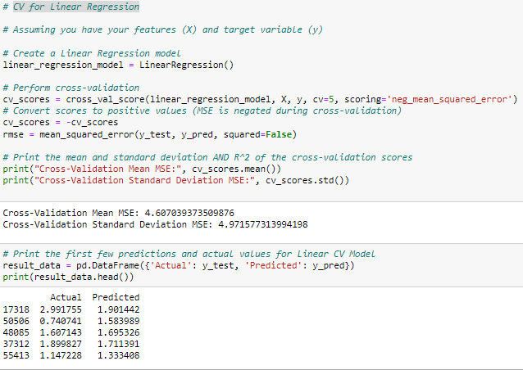
Cross Validation for Linear Regression

Slide 26
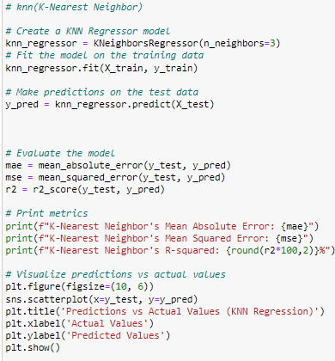
K-Nearest Neighbor Model

Slide 27
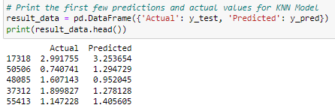
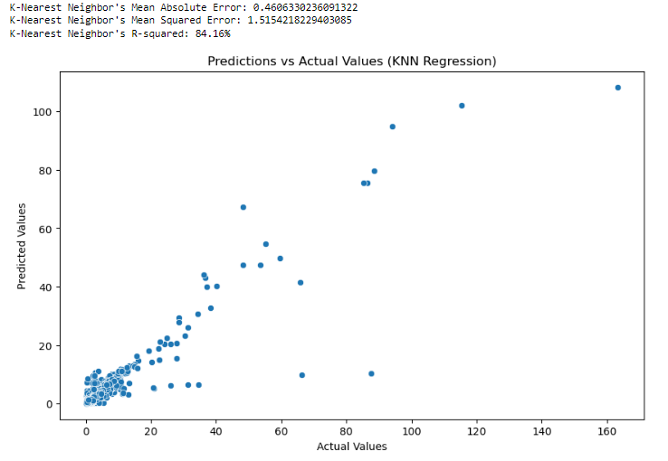
The first few predictions and actual values for K-Nearest Neighbor Model
We Train our splitted dataset in K-Nearest Neighbor model
calculate its performance in Mean Squared Error,Mean Absolute Error and Root of Mean Square error and Finally R-Squared %
Display the 5 values of Actual Values (y_test) and Predicted Values ( y_pred)
Plot A Scatter plot based on Actual Values and Predicted Values

Slide 28
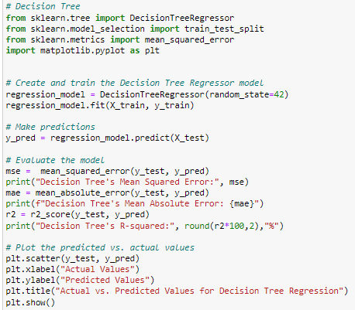
Decision Tree model

Slide 29
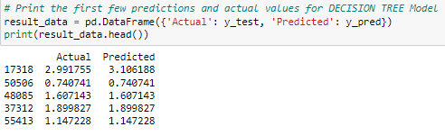
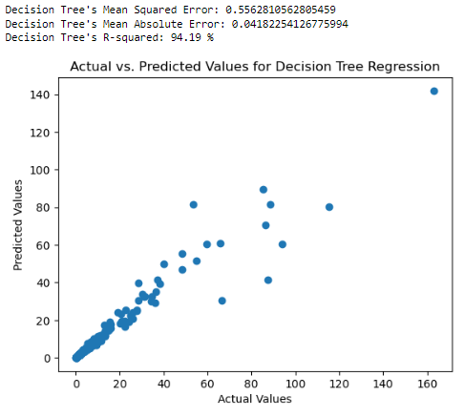
The first few predictions and actual values for Decision Tree Model
We Train our splitted dataset in Decision Tree model
calculate its performance in Mean Squared Error,Mean Absolute Error and Root of Mean Square error and Finally R-Squared %
Display the 5 values of Actual Values (y_test) and Predicted Values ( y_pred)
Plot A Scatter plot based on Actual Values and Predicted Values

Slide 30
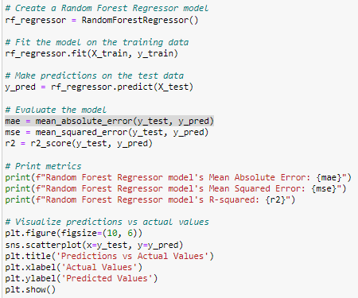
Random Forest model

Slide 31
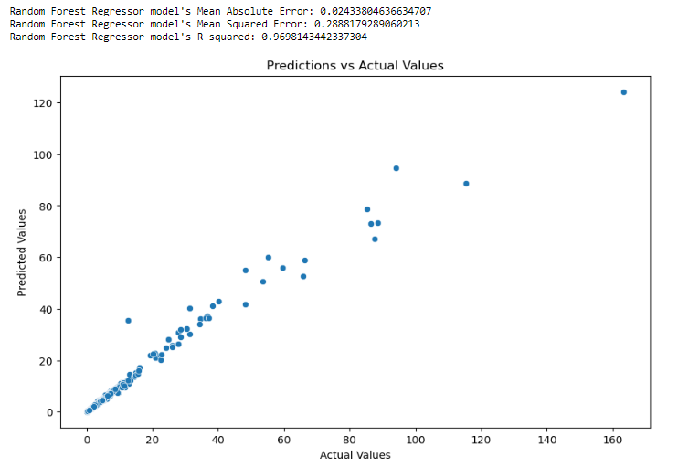
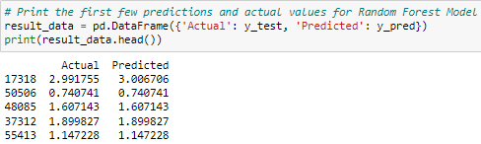
The first few predictions and actual values for Random Forest model
We Train our splitted dataset in Random Forest model
calculate its performance in Mean Squared Error,Mean Absolute Error and Root of Mean Square error and Finally R-Squared %
Display the 5 values of Actual Values (y_test) and Predicted Values ( y_pred)
Plot A Scatter plot based on Actual Values and Predicted Values

Slide 32


